Slide 1

Python Course Chapter 16
Playing with Images

Slide 2
Jython and JES
In this chapter, we will be using Jython to play around with images. Jython is an implementation of the Python programming language written in Java. Besides the Python built-in functions, Jython provides additional methods and classes to work with images.
First, we need to download JES (Jython Environment for Student).
Before we start manipulating the images, we need to know how pictures are encoded. Pictures are formed with pixels; each pixel is a dot combined with 3 colors – red, green, and blue.

Slide 3
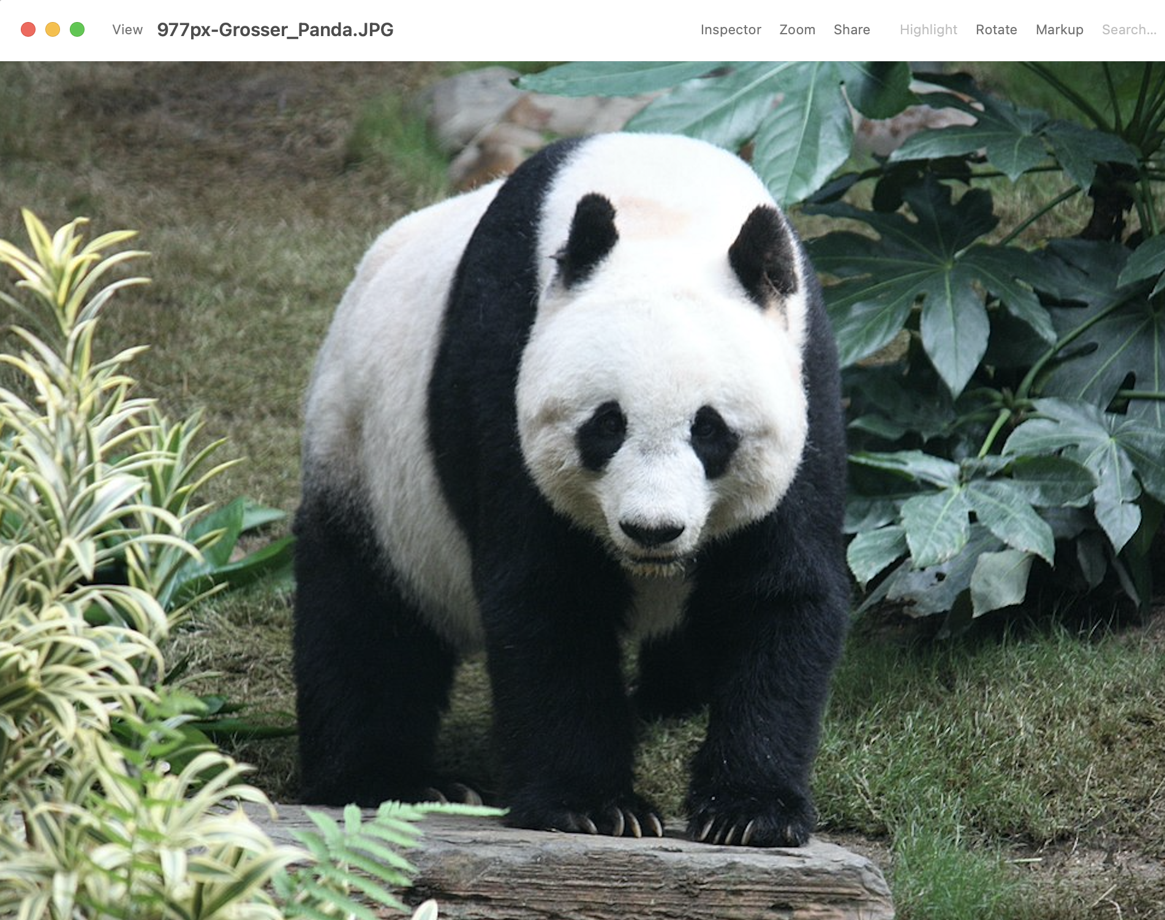
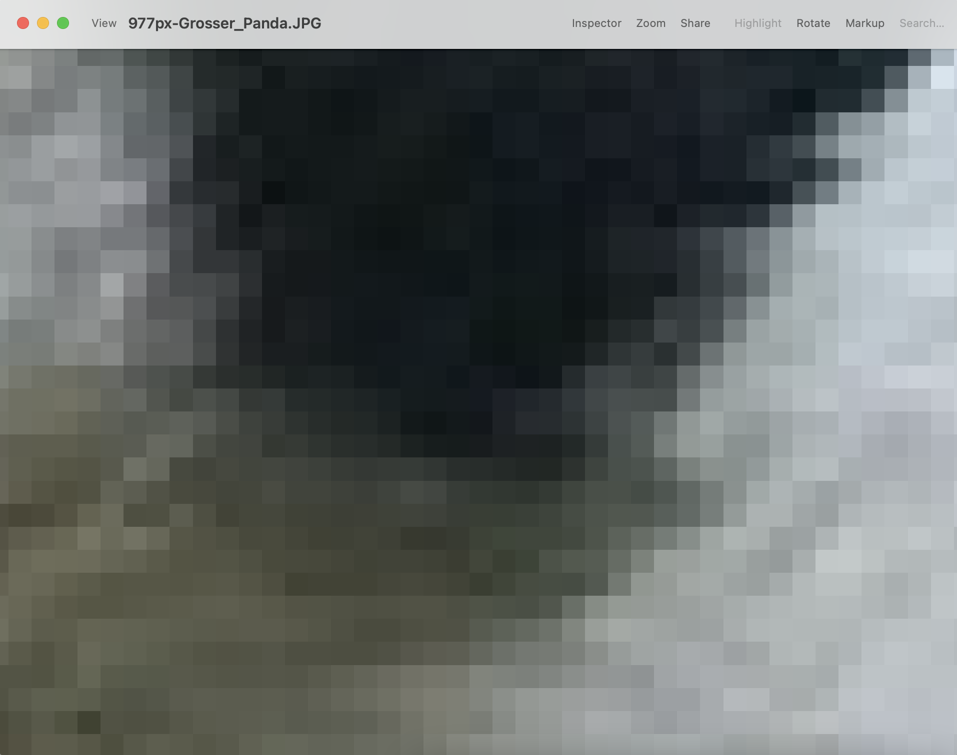
Jython and JES

Slide 4
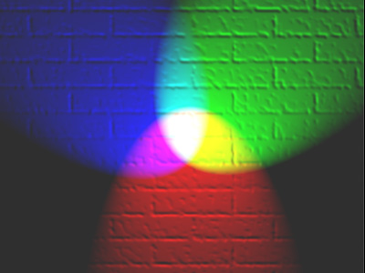
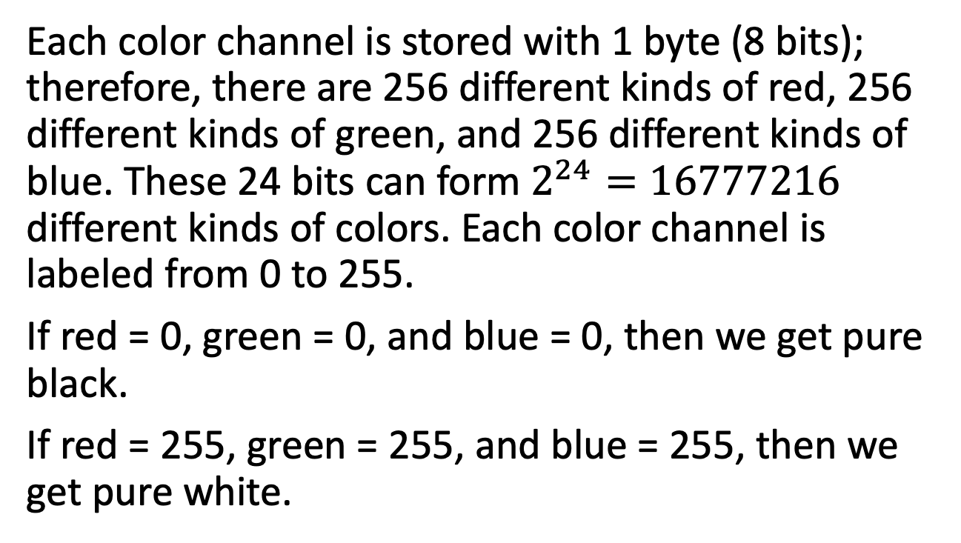
Jython and JES
Each color channel is stored with 1 byte (8 bits); therefore, there are 256 different kinds of red, 256 different kinds of green, and 256 different kinds of blue. These 24 bits can form $2^{24}=16777216$ different kinds of colors. Each color channel is labeled from 0 to 255.
If red = 0, green = 0, and blue = 0, then we get pure black.
If red = 255, green = 255, and blue = 255, then we get pure white.
Red, green, and blue lights combine and reflect from a wall.

Slide 5
Difference Between Python 2 and 3
We did not have a chance to talk about the major difference between Python 2 and 3; before working with JES, it’s a good time to learn about the difference since JES uses Python 2 syntax instead of Python 3.
Python 2 uses raw_input(), but Python 3 uses input().
Integer divided by integer will always return an integer in Python 2. If we want it to return a float, then we have to make either denominator or numerator a float.
Python 2 supports using print() method without parenthesis.
*. There are some other differences. Read more about it if interested.

Slide 6
Media Programming
Here’s some function in Jython we can use:
pickAFile() - opens a window for user to choose a file, and then returns the whole filepath of the chosen file.
makePicture(filepath) - takes a pathname as input, reads the file, and creates a picture from it. Returns a new picture.
show(picture) – shows a picture provided as input.
explore(picture) – shows a picture provided as input and allows users to explore x, y coordinates, red, green, and blue color values of each pixel.

Slide 7
Media Programming - Pictures
Here’s a list of functions we can use to work with pictures:
getWidth(picture) - Takes a picture as input and returns its length in the number of pixels left-to-right in the picture.
getHeight(picture) - Takes a picture as input and returns its length in the number of pixels top-to-bottom in the picture.
getPixels(picture) - Takes a picture as input and returns a list of all the pixels in the picture.
getPixel(picture, xpos, ypos) - Takes a picture, an x position and a y position (two numbers), and returns the Pixel object at that point in the picture.

Slide 8
Media Programming - Colors
getColor(pixel) - Takes a Pixel and returns the Color object at that pixel.
getRed(pixel) - Takes a Pixel object and returns the integer (between 0 and 255) of the amount of redness in that pixel.
getGreen(pixel) - same as getRed(pixel) but return green value.
getBlue(pixel) - same as getRed(pixel) but return blue value.

Slide 9
Media Programming - Colors
setColor(pixel, color) - Takes in a pixel and a color object and sets the pixel to the given color.
makeColor(r, g, b) - Takes three integer inputs for the red, green, and blue components (in order) and returns a color object.
setRed(pixel, int) - Takes in a Pixel object and an integer (between 0 and 255) and sets the redness of that pixel to the given value.
serGreen(pixel, int) - same as setRed(pixel, int) but for green.
setBlue(pixel, int) - same as setRed(pixel, int) but for blue.

Slide 10
Media Programming - Others
getX(pixel) - Takes in a pixel object and returns the x position of where that pixel is in the picture.
getY(pixel) - Takes in a pixel object and returns the y position of where that pixel is in the picture.
writePictureTo(picture, path) - Takes a picture and a file name (string) as input, then writes the picture to the file as a JPEG, PNG, or BMP. (Be sure to end the filename in ".jpg" or ".png" or ".bmp" for the operating system to understand it well.)
pickAFolder() - Opens a file chooser to let the user pick a folder and returns the complete path name as a string. Takes no input.

Slide 11
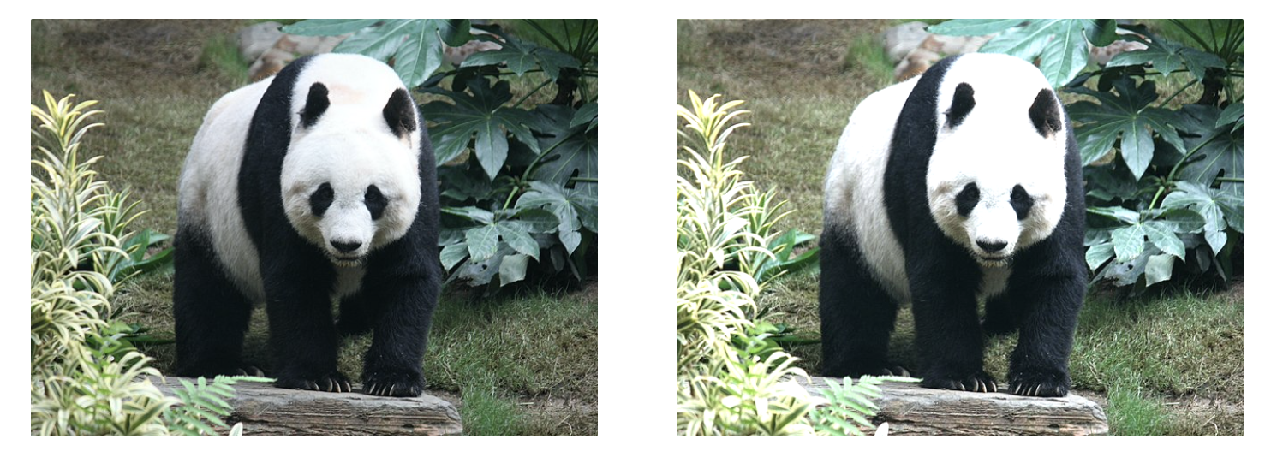
Playing with Picture - Brighter
If a picture is too dark, then we can lighten the picture. What does it mean to make a picture lighter? It literally means – we take all pixels in a picture and increase the RGB value in each pixel. Increased RGB value makes each pixel move towards white; the whole picture will turn brighter.

Slide 12
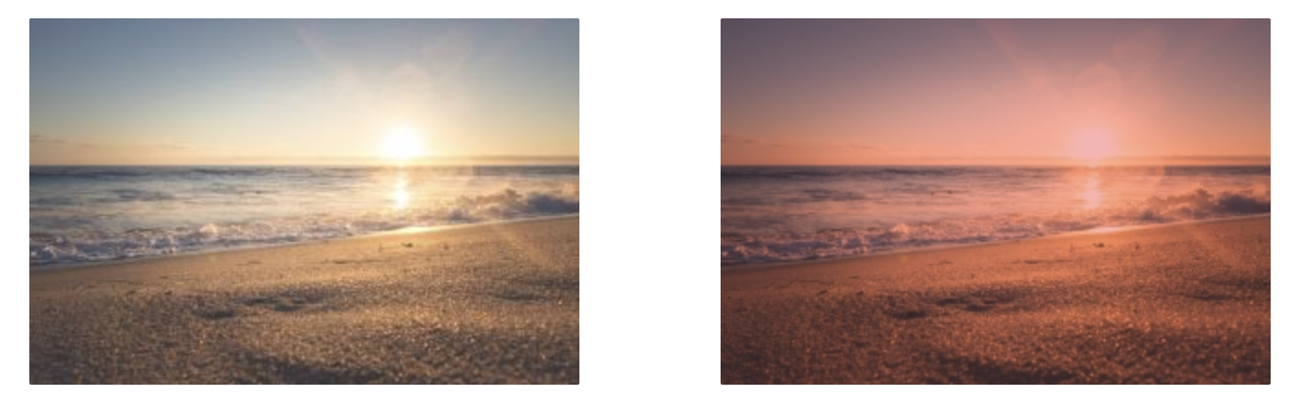
Playing with Picture – Fake Sunset
We can make a fake sunset from a beach picture. How to make it? We need to decrease each pixel's green and blue values by 30%; then, each pixel’s redness becomes more dominant. Then, the picture starts to look like a sunset.

Slide 13
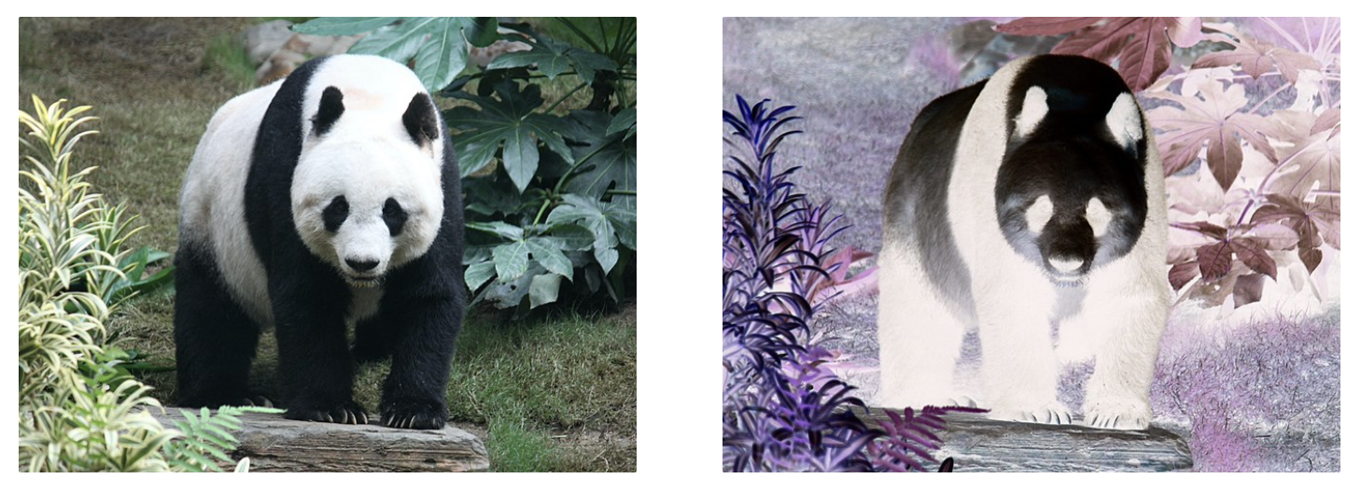
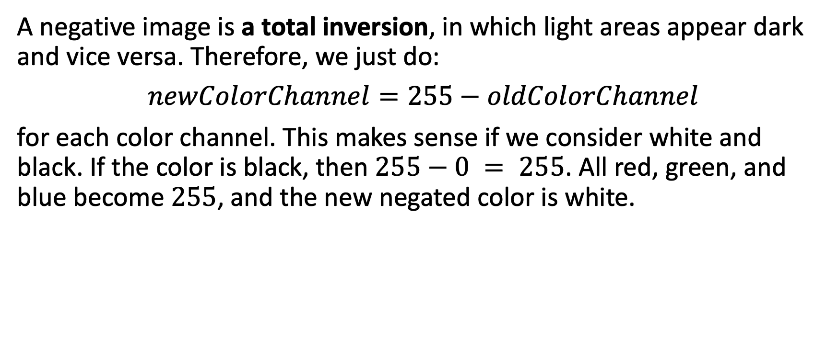
Playing with Picture - Negate A Picture
A negative image is a total inversion, in which light areas appear dark and vice versa. Therefore, we just do:
$newColorChannel=255−oldColorChannel$
for each color channel. This makes sense if we consider white and black. If the color is black, then $255−0 = 255$. All red, green, and blue become $255$, and the new negated color is white.

Slide 14
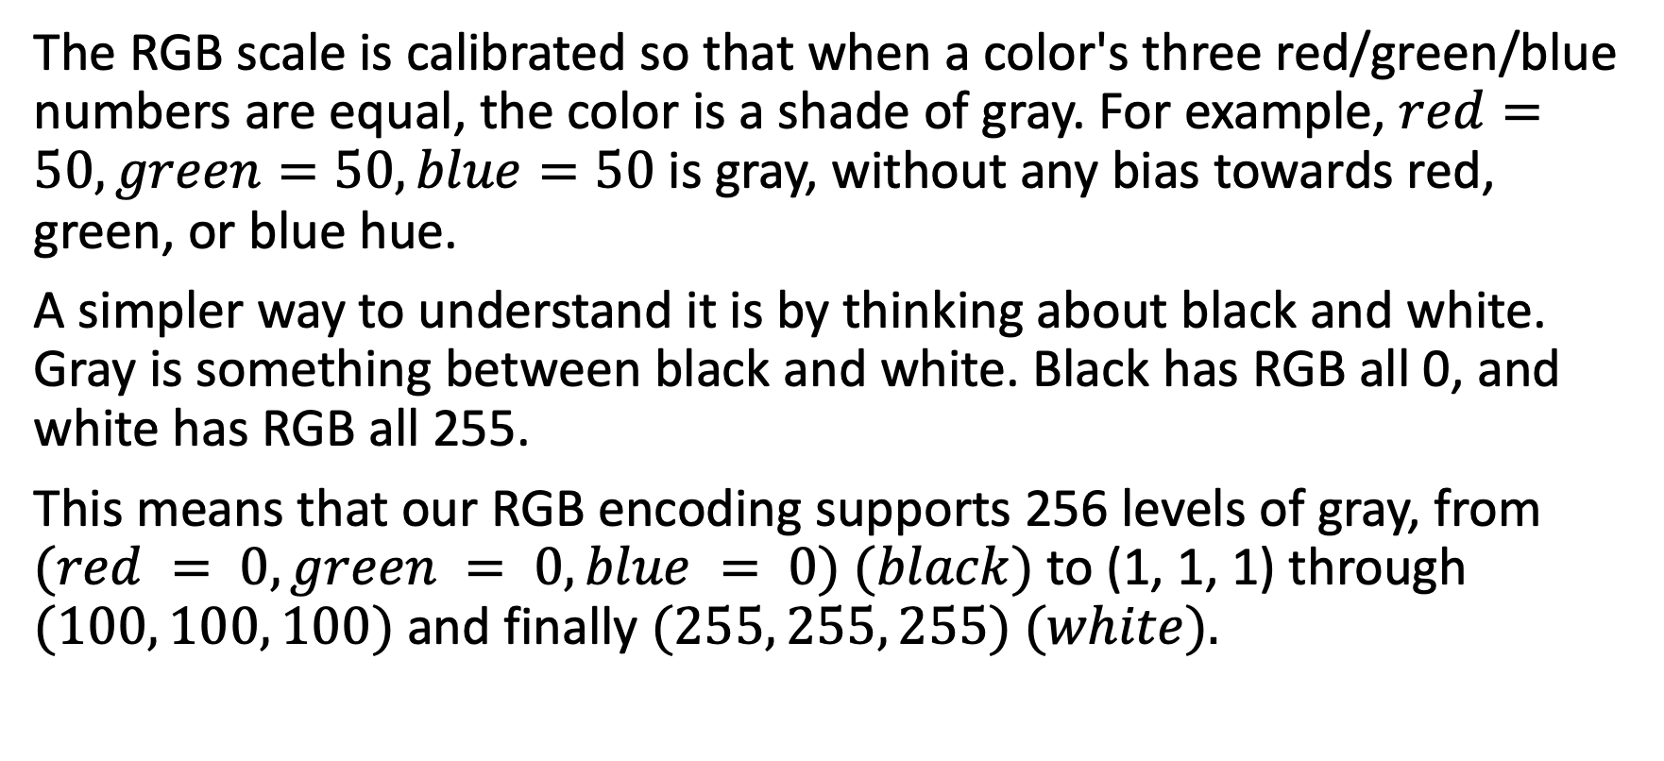
Playing with Picture – Grayscale
The RGB scale is calibrated so that when a color's three red/green/blue numbers are equal, the color is a shade of gray. For example, $red=50,green=50,blue=50$ is gray, without any bias towards red, green, or blue hue.
A simpler way to understand it is by thinking about black and white. Gray is something between black and white. Black has RGB all 0, and white has RGB all 255.
This means that our RGB encoding supports 256 levels of gray, from $(red = 0, green = 0, blue = 0) (black)$to (1, 1, 1) through $(100, 100, 100)$and finally $(255, 255, 255) (white).$

Slide 15
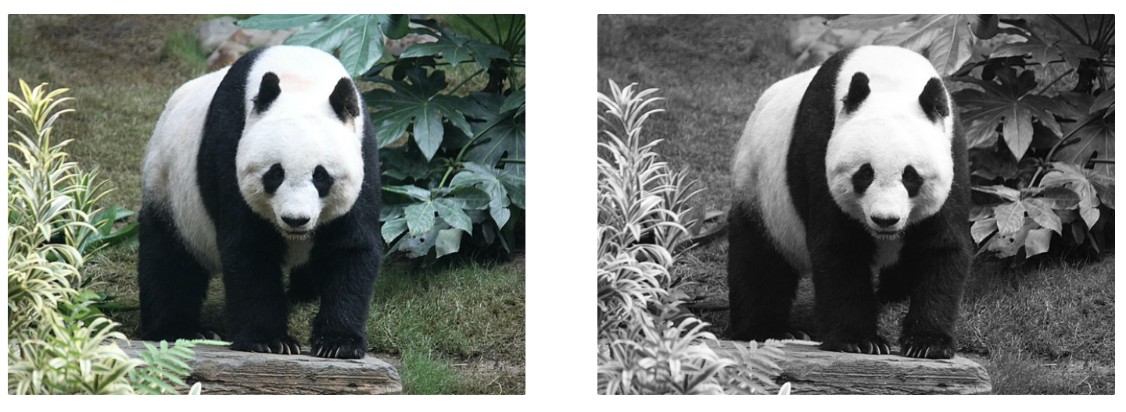
Playing with Picture – Grayscale
If we want to turn a picture into black/white picture, then the tricky part is figuring out what the replicated value should be. It turns out that there is a pretty easy way to compute it: we average the three component colors for each pixel.

Slide 16
Playing with Picture – Copy Top Half
If we want to copy the top half of the picture to the bottom half, then we need to think about – how do we find the mirror point in a list? If we consider a list:
The total length of this list is 7, and the middle point is index 3. If we pair up the elements, then we get:
(0, 6), (1, 5), (2, 4), (3, 3)

Slide 17
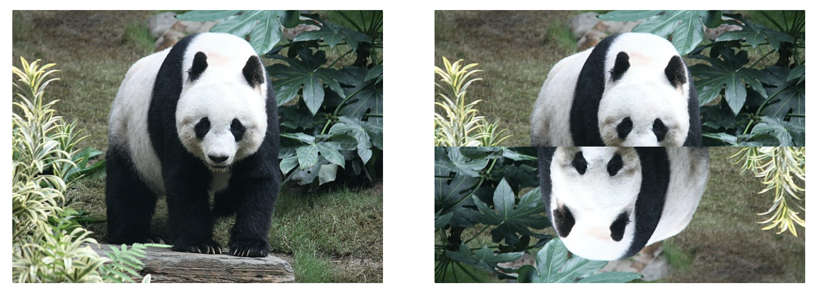
Playing with Picture – Copy Top Half
The math relation will be:
(index, len(list) – 1 – index)
Index means the distance of the first index to our current index (counting from the left), and len(list) – 1 – index means the distance of the last index to the mirrored point (counting from the right).

Slide 18

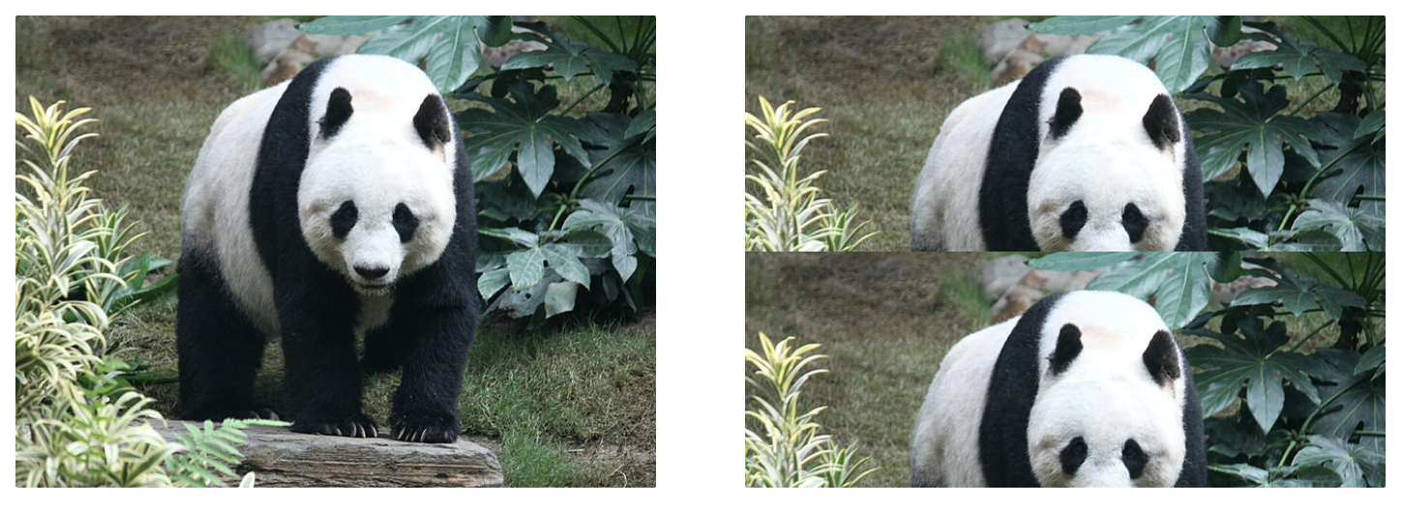
Playing with Picture – Copy Top Half II
If we want to copy the top half of the picture to the bottom half, we can also loop through half of the pixels in the picture, and then find the mirror point.
Pixels are paired up by (0, 3), (1, 4), (2, 5); If we copy the top half to the bottom half with this formula, we get:

Slide 19
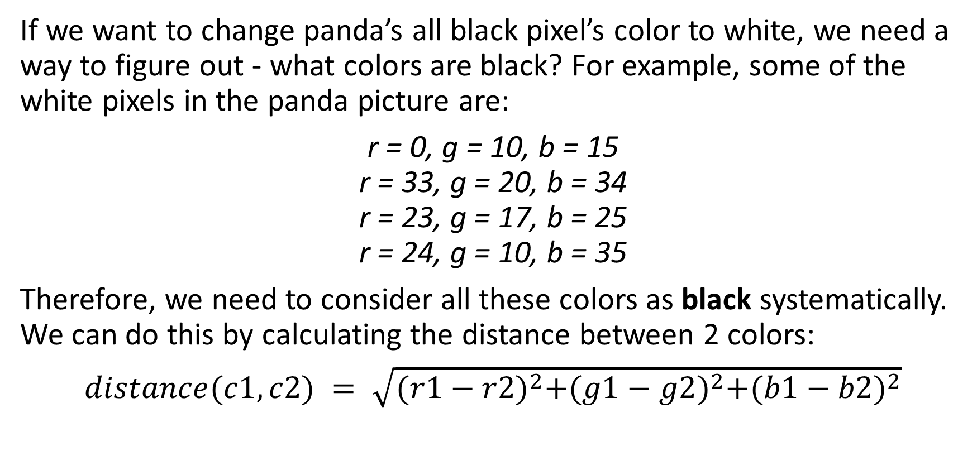
Pictures Technique with Selection
If we want to change panda’s all black pixel’s color to white, we need a way to figure out - what colors are black? For example, some of the white pixels in the panda picture are:
r = 0, g = 10, b = 15 r = 33, g = 20, b = 34 r = 23, g = 17, b = 25 r = 24, g = 10, b = 35
Therefore, we need to consider all these colors as black systematically. We can do this by calculating the distance between 2 colors:
$distance(c1, c2) = \sqrt{{(r1−r2)}^{2}+{(g1−g2)}^{2}+{(b1−b2)}^{2}}$

Slide 20
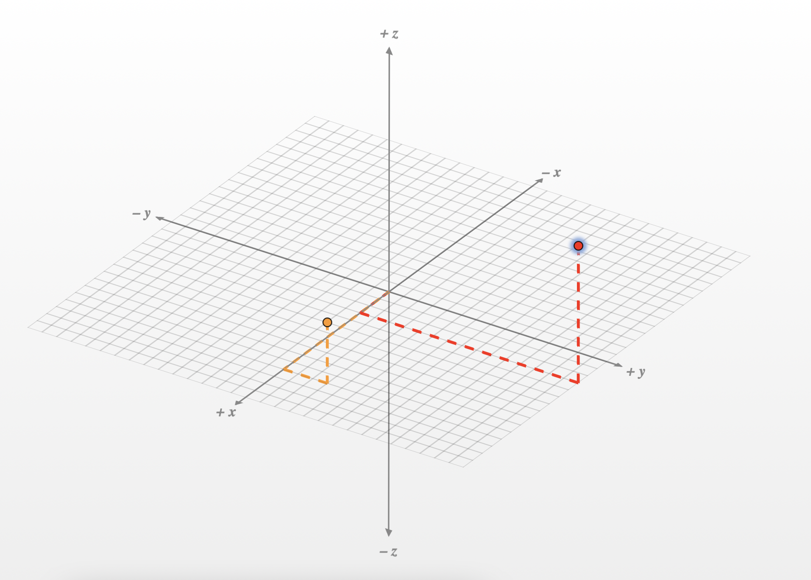
Pictures Technique with Selection
This means we have to consider each color as a vector or dot in a three-dimensional space.
The distance between 2 colors can be found by finding the cartesian distance of 2 dots.
Jython has a built-in function called distance(c1, c2) that can do this math for us.

Slide 21
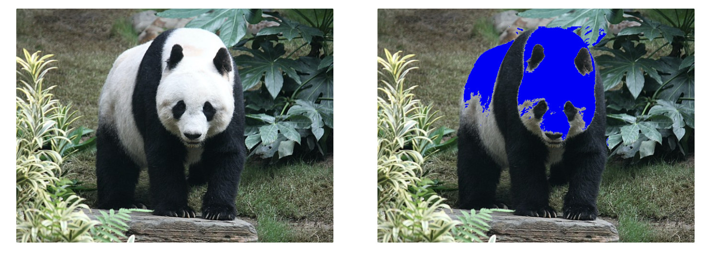
Pictures Technique – Blue Panda
We can change the panda to a blue panda by using the distance function. We have to loop through a particular picture area, use the distance function to find the pixels close to the color WHITE, and then change it to blue.

Slide 22
Pictures Technique – Edge Detection
Edge detection is an image processing technique for finding the boundaries of objects within images. It works by detecting discontinuities in brightness. Edge detection is used for image segmentation and data extraction in image processing, computer vision, and machine vision.
This is also a built-in functionality in our human visual system. For example, there are no clear lines around your nose or eyes, but any child can draw a face with a checkmark for a nose and two circles for eyes—and we will all recognize it as a face!

Slide 23
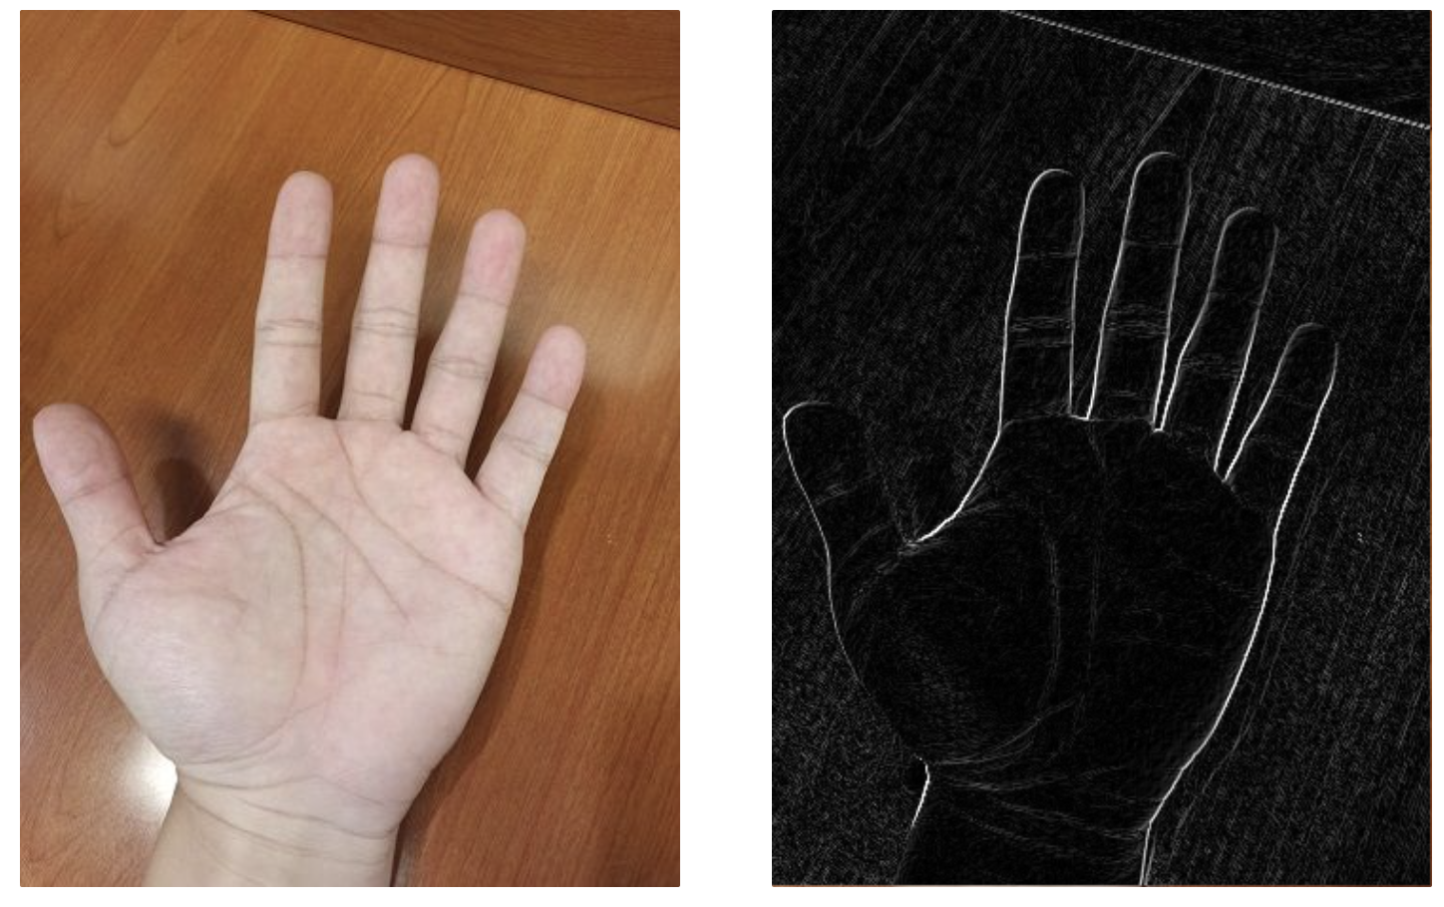
Pictures Technique – Edge Detection
An algorithm for image edge detection is finding “how different I am with the pixel on my right bottom side?”. If there is no difference or only a tiny difference, I will set myself to black. If there is a huge difference, then set myself to white.
If we want to extract background, then we can first do edge detection, then use an algorithm to only keep the pixels circled by the white lines.

Slide 24
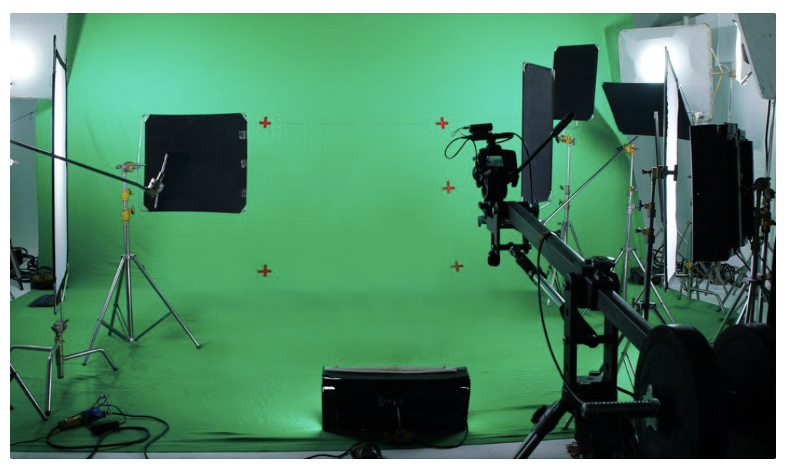
Pictures Technique - Chromakey
Television weather forecasters wave to show a storm front coming in across a map.
The reality is that they are being filmed standing before a background of a fixed color (usually blue or green), and then that background color is replaced digitally with pixels from the desired map; this is called chromakey.

Slide 25
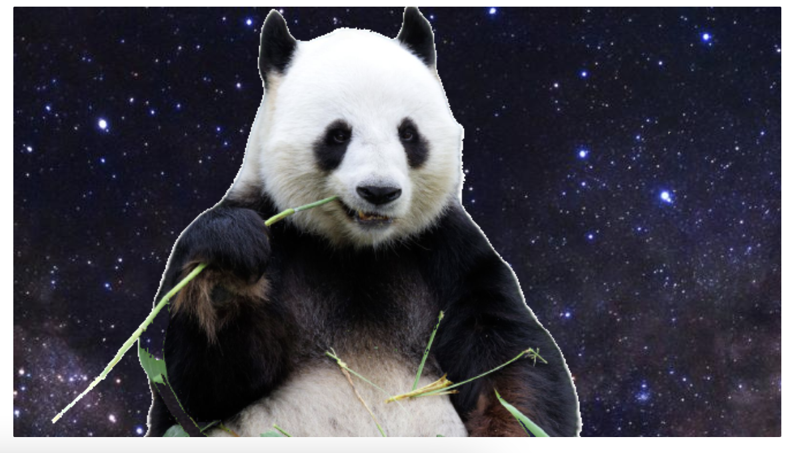
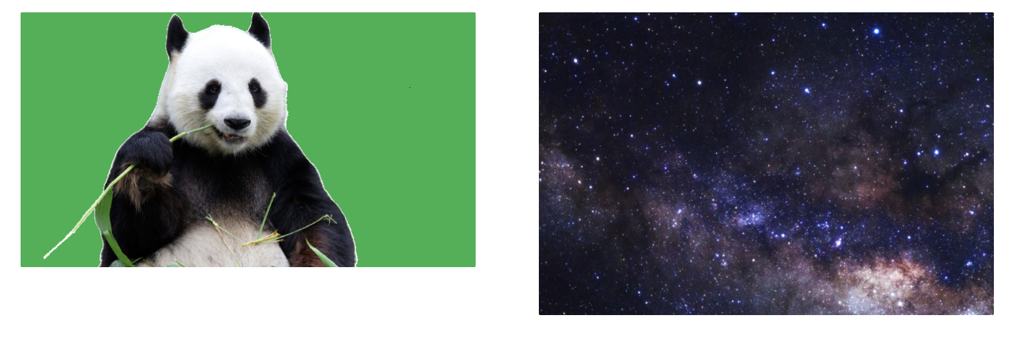
Pictures Technique - Chromakey
Given a picture, how do we detect the green background? Well, if blue + red is less than green, than that’s a green!!
*. Notice that the background must be the same size as or bigger than the green background picture.

Slide 26
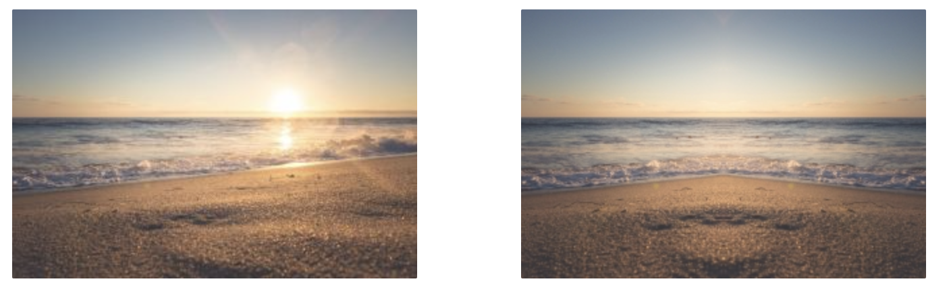
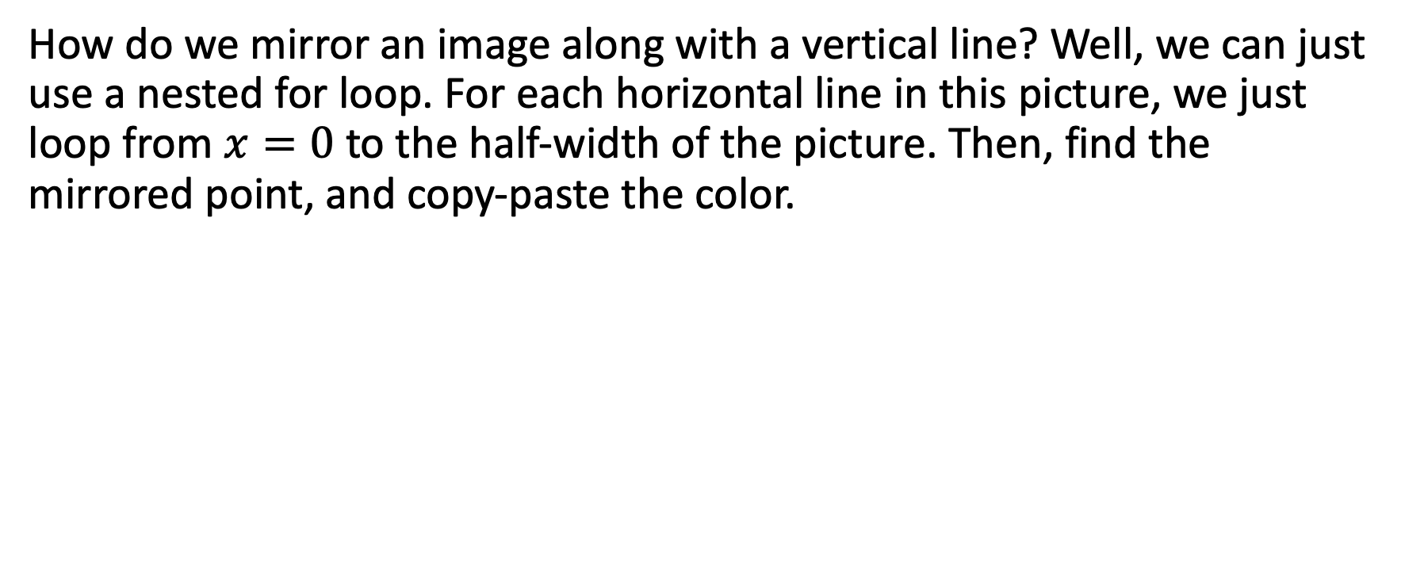
Mirroring an Image – Along with Vertical Line
How do we mirror an image along with a vertical line? Well, we can just use a nested for loop. For each horizontal line in this picture, we just loop from $x=0$to the half-width of the picture. Then, find the mirrored point, and copy-paste the color.

Slide 27
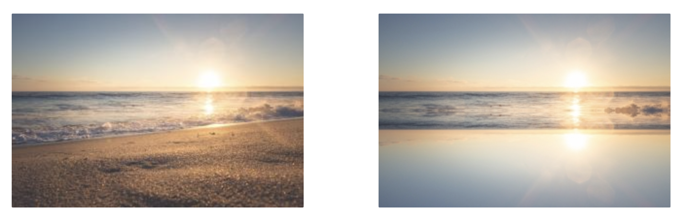
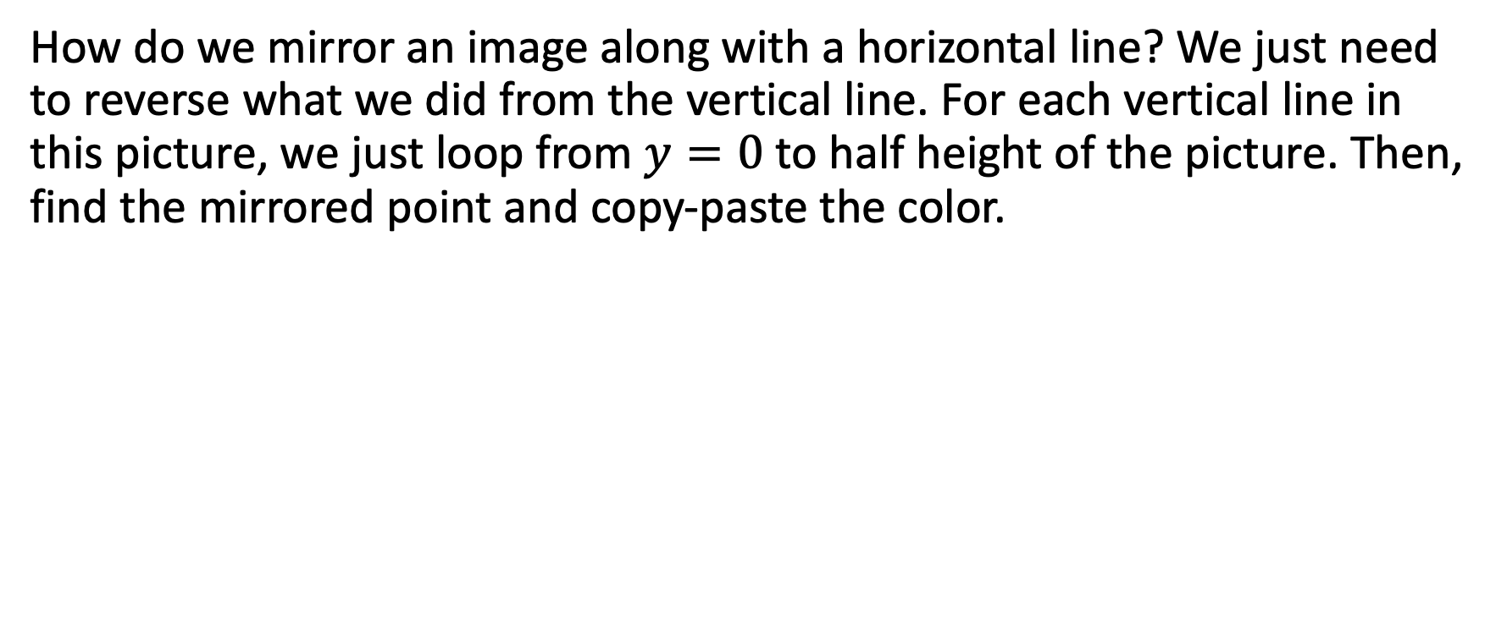
Mirroring an Image – Along with Horizontal Line
How do we mirror an image along with a horizontal line? We just need to reverse what we did from the vertical line. For each vertical line in this picture, we just loop from $y=0$ to half height of the picture. Then, find the mirrored point and copy-paste the color.

Slide 28
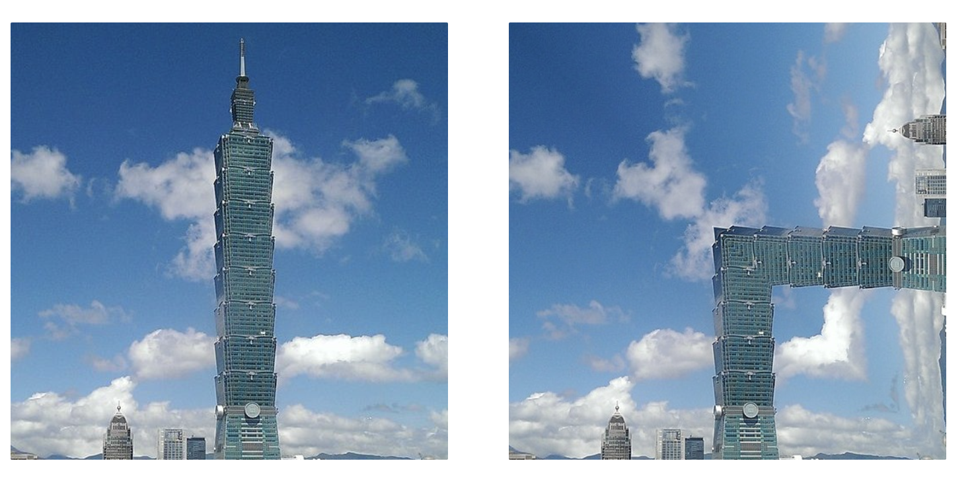
Mirroring an Image – Along with Diagonal 1
What if we want to mirror an image along with a diagonal? In this case, we are only considering the situation when the picture is square.
This is the effect we want:

Slide 29
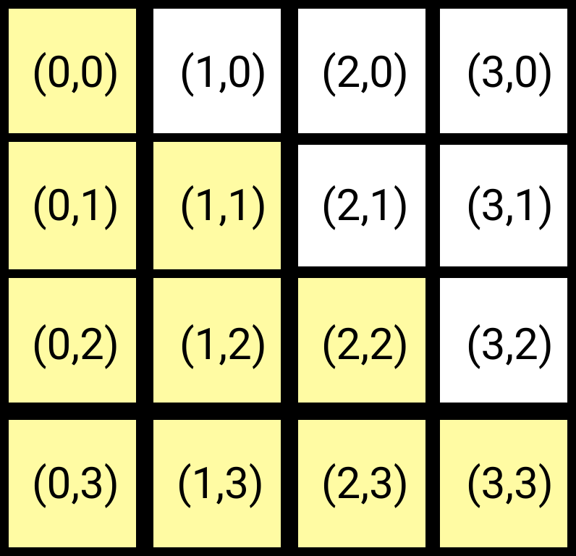
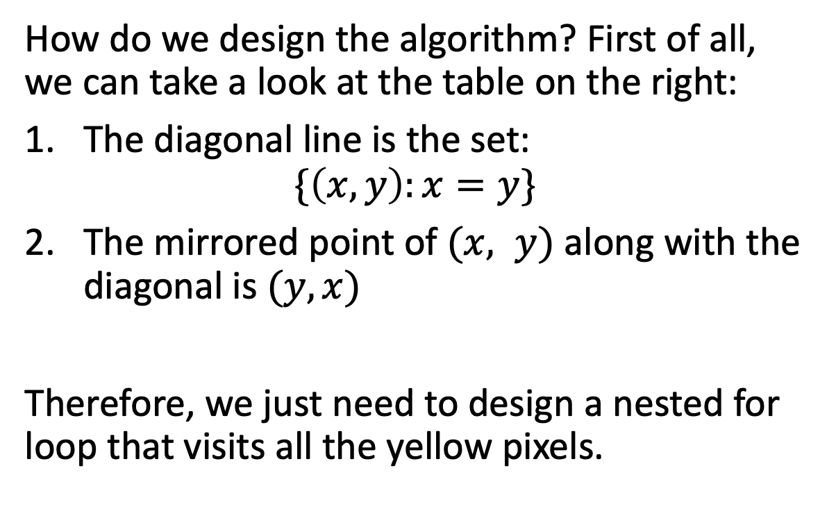
Mirroring an Image – Along with Diagonal 1
How do we design the algorithm? First of all, we can take a look at the table on the right:
The diagonal line is the set: $\{\left(x, y\right):x=y\}$
The mirrored point of $(x, y)$ along with the diagonal is $(y, x)$
Therefore, we just need to design a nested for loop that visits all the yellow pixels.

Slide 30
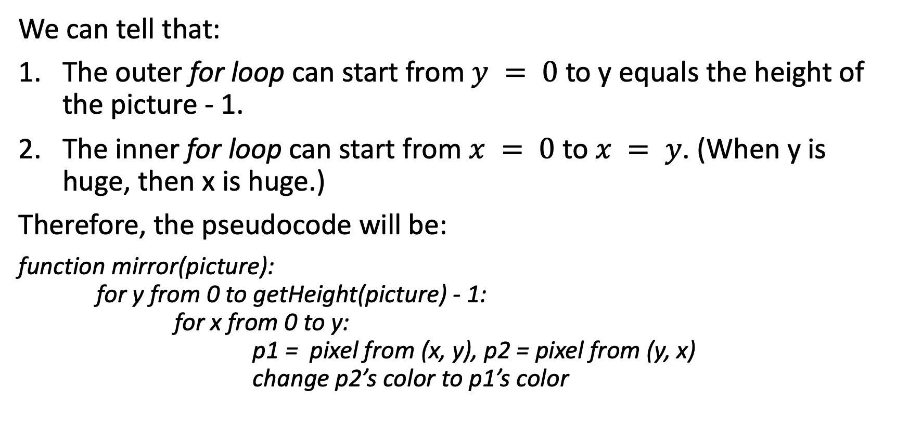
Mirroring an Image – Along with Diagonal 1
We can tell that:
The outer for loop can start from $y = 0$to y equals the height of the picture - 1.
The inner for loop can start from $x = 0$ to $x = y$. (When y is huge, then x is huge.)
Therefore, the pseudocode will be:
function mirror(picture): for y from 0 to getHeight(picture) - 1: for x from 0 to y: p1 = pixel from (x, y), p2 = pixel from (y, x) change p2’s color to p1’s color

Slide 31
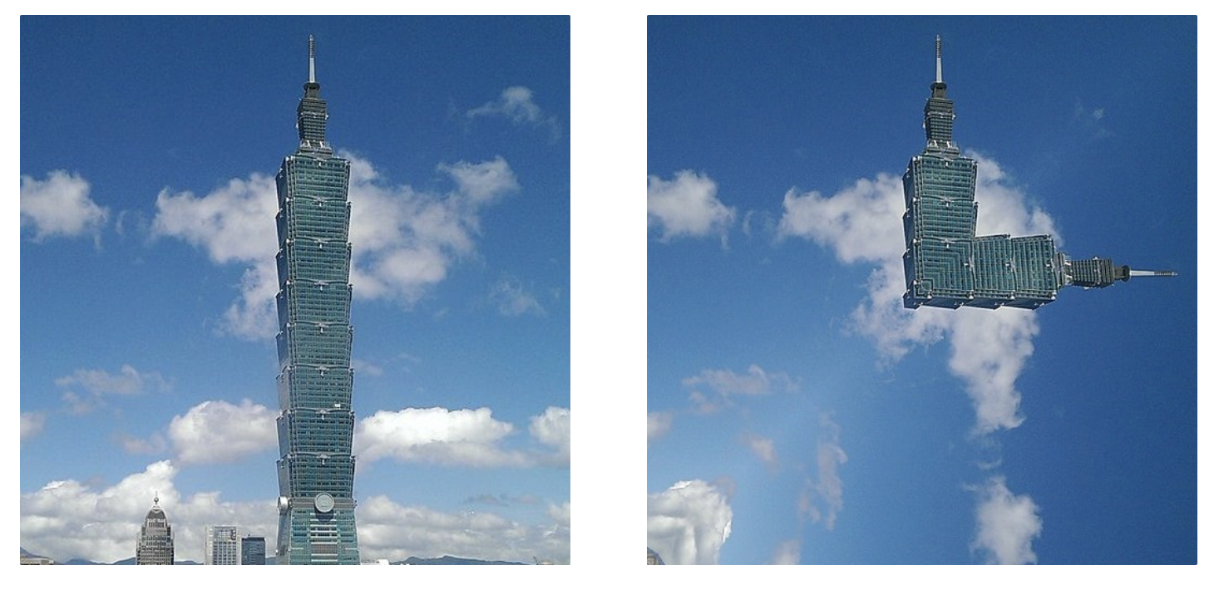
Mirroring an Image – Along with Diagonal 2
What if we want to mirror an image along with the other diagonal? In this case, we also assume the picture is square.
This is the effect we want:

Slide 32
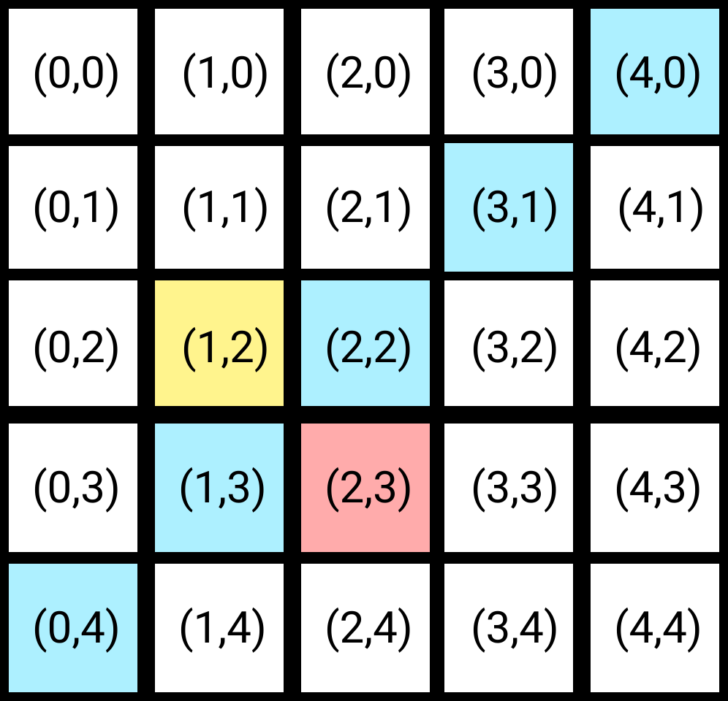
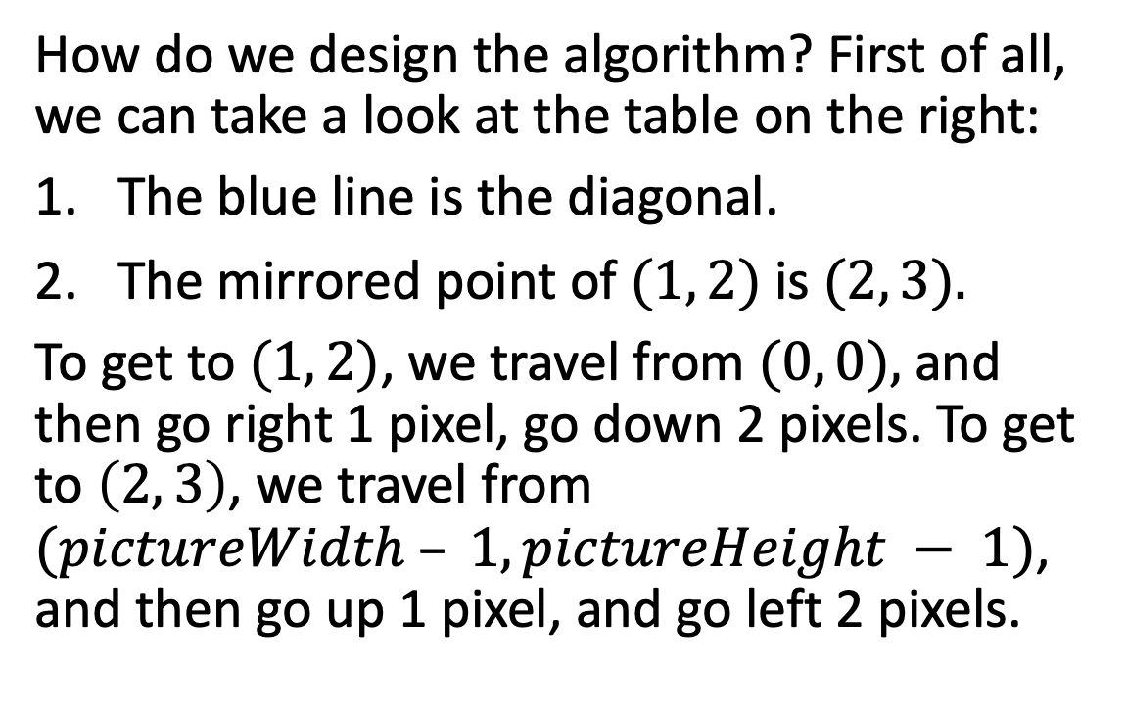
Mirroring an Image – Along with Diagonal 2
How do we design the algorithm? First of all, we can take a look at the table on the right:
The blue line is the diagonal.
The mirrored point of $(1, 2)$is $(2, 3).$
To get to $(1, 2)$, we travel from $(0, 0),$and then go right 1 pixel, go down 2 pixels. To get to $\left(2, 3\right)$, we travel from $(pictureWidth – 1, pictureHeight − 1)$, and then go up 1 pixel, and go left 2 pixels.

Slide 33
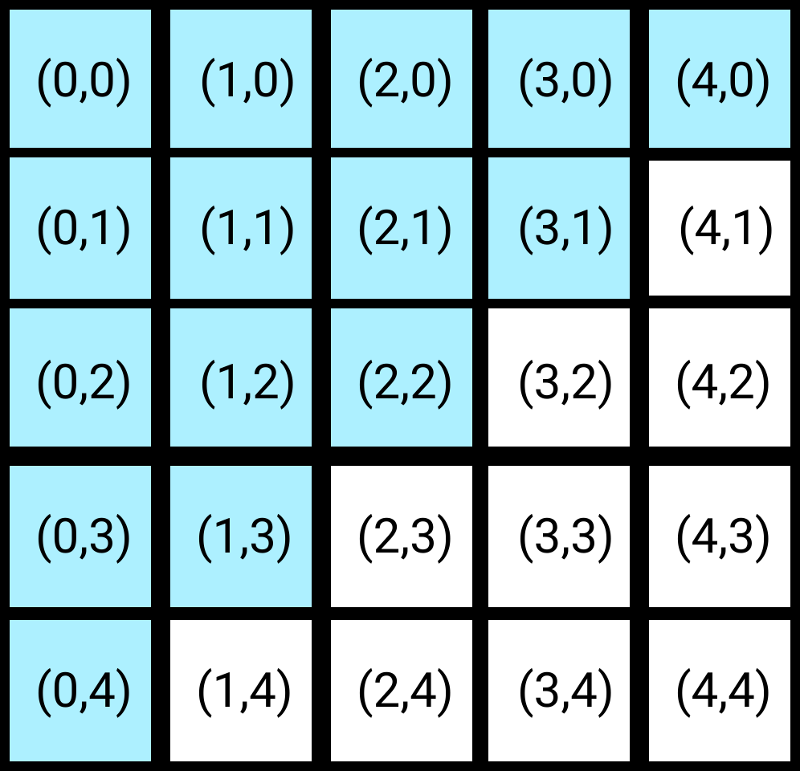
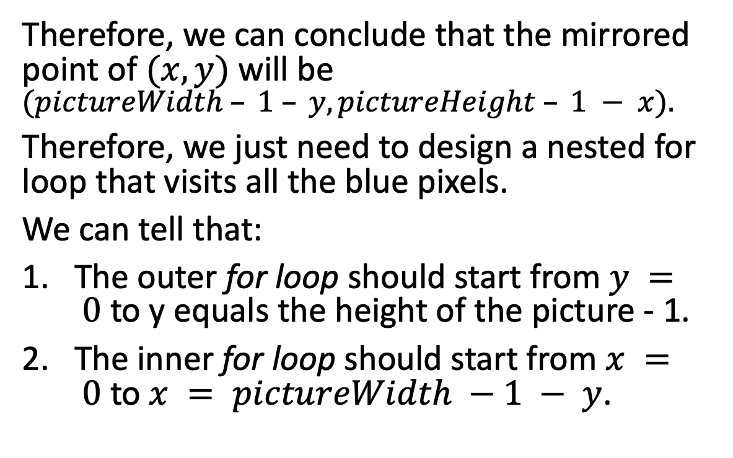
Mirroring an Image – Along with Diagonal 2
Therefore, we can conclude that the mirrored point of $(x, y)$will be $(pictureWidth – 1 – y, pictureHeight – 1 − x).$
Therefore, we just need to design a nested for loop that visits all the blue pixels.
We can tell that:
The outer for loop should start from $y = 0$to y equals the height of the picture - 1.
The inner for loop should start from $x = 0$to $x = pictureWidth −1 − y$.

Slide 34
Mirroring an Image – Along with Diagonal 2
Therefore, the pseudocode will be:
function mirror(picture): for y from 0 to getHeight(picture) - 1: for x from 0 to getWidth(picture) – 1 - y: p1 = pixel from (x, y) p2 = pixel from(getHeight(pic)-1-y,getWidth(pic)-1-x) change p2’s color to p1’s color

Slide 35
MISC – Copy the Picture to Somewhere Else
In JES, a function called makeEmptyPicture(width, height) can create a new empty picture. If we want to copy a picture somewhere else, we can call the called makeEmptyPicture(width, height) first. Then, we can iterate through the original picture and copy each pixel’s color to the new empty picture.

Slide 36
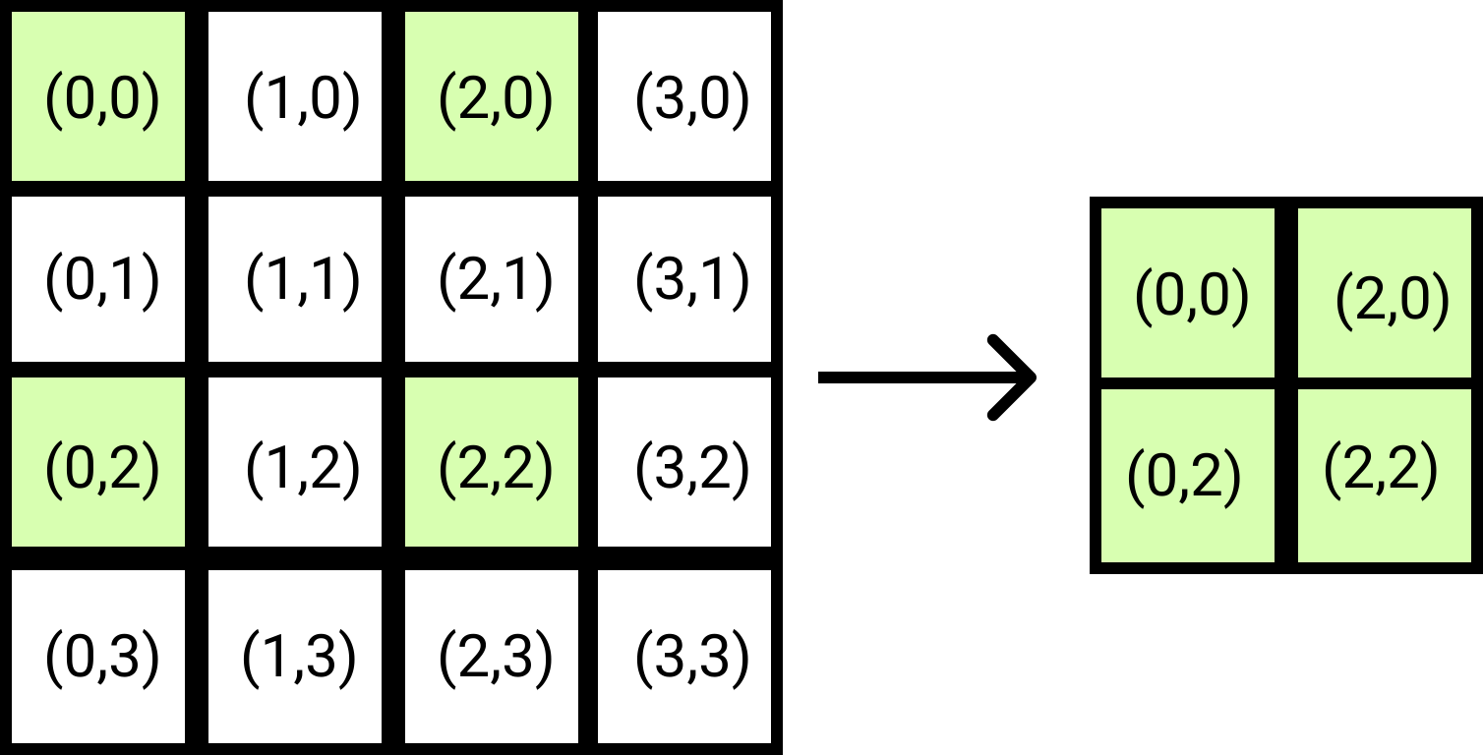
MISC – Scale Down an Image
Resizing an image is a common task for a computer to perform. How can we scale down in image? A practical and straightforward approach is – for every 4 pixels, we only copy the top-right pixel and paste it to the new empty picture. (This does not sound realistic. However, it does work!!)

Slide 37
MISC – Scale Down an Image
Here’s the pseudocode:
function scaleDown(pic): w = getWidth(pic) h = getHeight(pic) canvas = new empty picture with size = (w/2, h/2) targetX = 0 targetY = 0 for x from 0 to w, step = 2: for y from 0 to h, step = 2: p1 = get pixel from pic at x, y p2 = get pixel from canvas at targetX, targetY set p2’s color to p1’s color targetY = targetY + 1 targetX = targetX + 1 targetY = 0

Slide 38
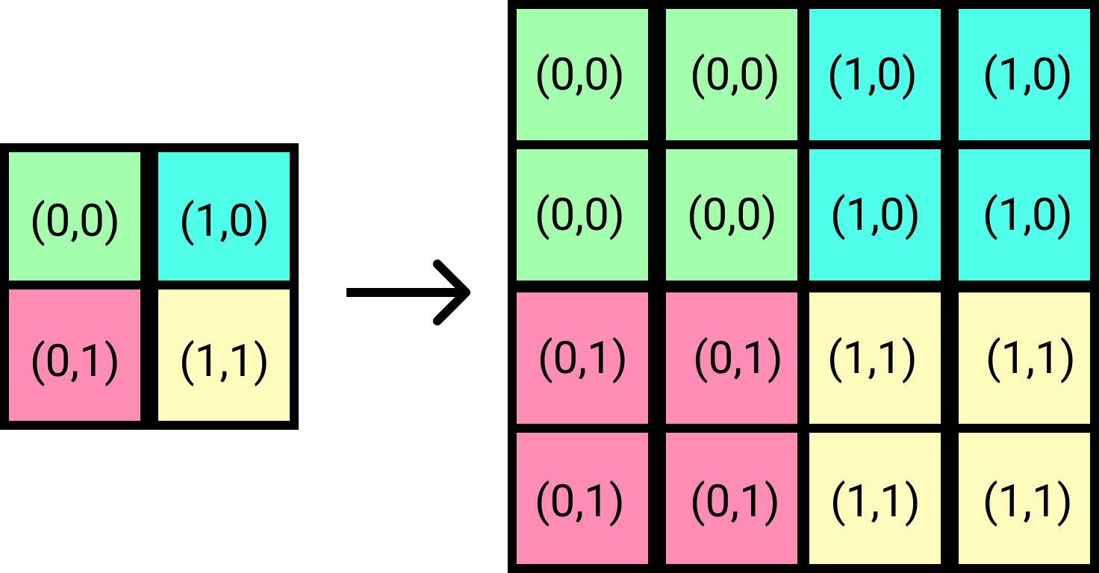
MISC – Scale Up an Image
Scaling an image up is similar to what we did. We make four new copies for every pixel in the original picture and put them on the new empty picture.

Slide 39
MISC – Scale Up an Image
Here’s the pseudocode:
function scaleUp(pic): w = getWidth(pic) h = getHeight(pic) canvas = new empty picture with size = (w*2, h*2) targetX = 0 targetY = 0 for x from 0 to w: for y from 0 to h: p1 = get pixel from pic at x, y p2 = get pixel from canvas at targetX, targetY p3 = p2’s right, p4 = p2’s bottom, p5 = p2’s bottom right set p2, p3, p4, p5 color to p1’s color targetY = targetY + 2 targetX = targetX + 2 targetY = 0

Slide 40
MISC - Blur
Due to the nature of the algorithm, when we make pictures larger (scaling them up), we usually get rough edges and sharp steps in lines that we call pixelation.
One way to improve it is by blurring the image. There are tons of different blurring algorithms; the one we will be using works in this way:
We take one pixel’s top, right, bottom, and left pixels, and find the average value of red, green and blue.
Change the central pixel value to the red, green, and blue average we found at step 1.

Slide 41
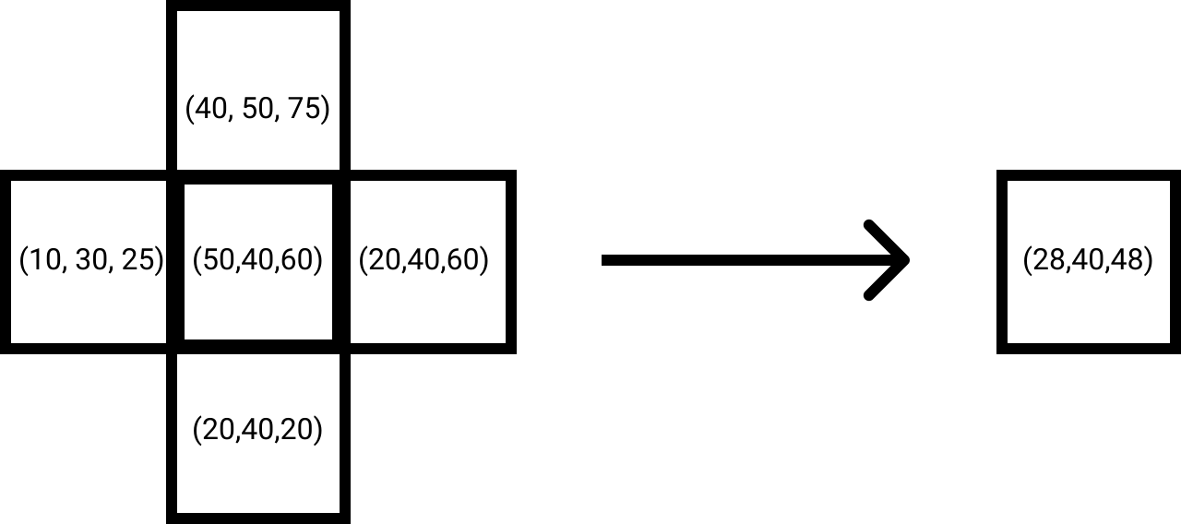
MISC - Blur
This blurring algorithm aims to reduce the difference between one pixel’s color and its neighbor pixels’ color.

Slide 42
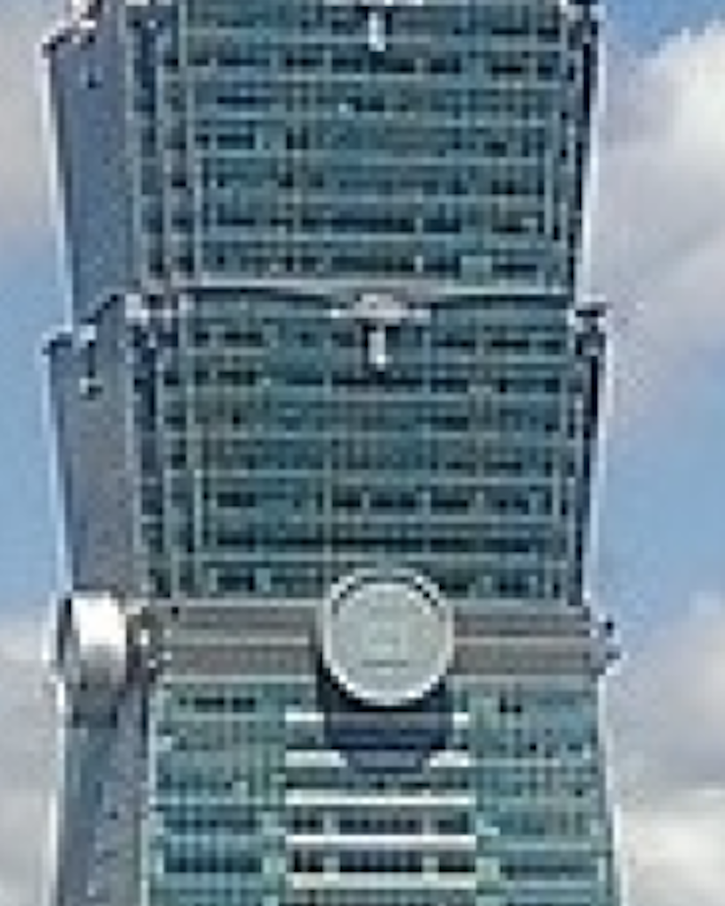
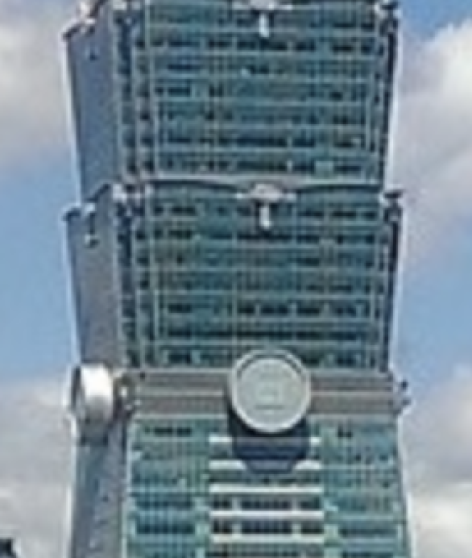
MISC - Blur
Here’s the difference of a scaled up picture before blurring and after blurring.
We can see sharp edges.
No more sharp edges after blurring.

